Slide 1
Project Meeting
2019.03.29

Slide 2
Flow Chart of Working Architecture
LoRaWAN
LoRa Sensor node ( Raspberry Pi 3 )
LoRa Gateway ( Raspberry Pi 3 )
LoRa
Antenna
(SX1276)
LoRa
Antenna
(SX1276)
LoRa receipt.py
LoRa transmission.py
Message
Management program
Smart meter
Simulator.py
DNN
container
BC
container
Smart meter Dataset.csv

Slide 3
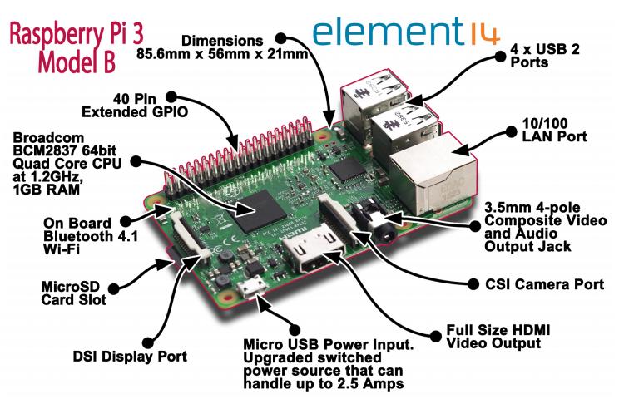
Specification of Raspberry Pi 3 (1/7) Physical Layout
Source: https://www.terraelectronica.ru/pdf/show?pdf_file=%252Fds%252Fpdf%252FT%252FTechicRP3.pdf

Slide 4
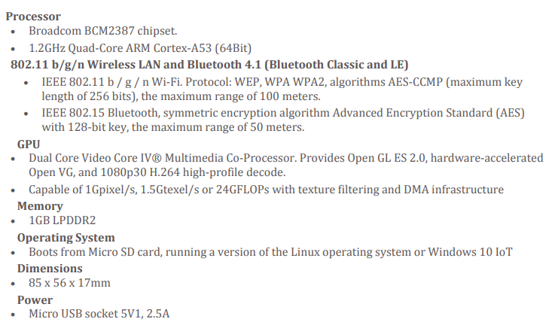
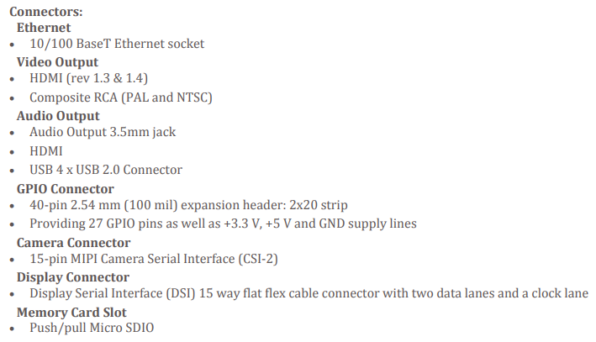
Specification of Raspberry Pi 3 (2/7) Hardware Specification
Source: https://www.terraelectronica.ru/pdf/show?pdf_file=%252Fds%252Fpdf%252FT%252FTechicRP3.pdf

Slide 5
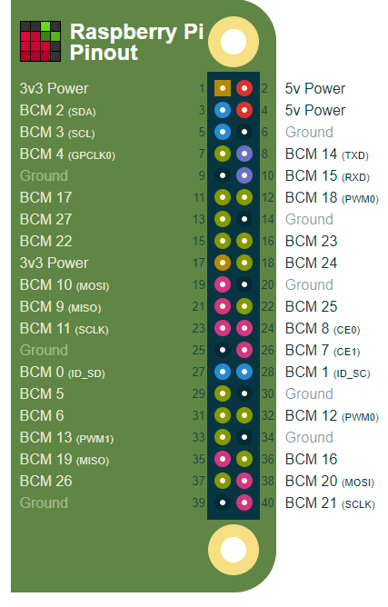
Specification of Raspberry Pi 3 (3/7) GPIO Highlight
PWM (pulse-width modulation)
Software PWM available on all pins
Hardware PWM available on GPIO12, GPIO13, GPIO18, GPIO19
SPI
SPI0: MOSI (GPIO10); MISO (GPIO9); SCLK (GPIO11); CE0 (GPIO8), CE1 (GPIO7)
SPI1: MOSI (GPIO20); MISO (GPIO19); SCLK (GPIO21); CE0 (GPIO18); CE1 (GPIO17); CE2 (GPIO16)
I2C
Data: (GPIO2); Clock (GPIO3)
EEPROM Data: (GPIO0); EEPROM Clock (GPIO1)
Serial
TX (GPIO14); RX (GPIO15)
27 GPIO (Data exchange)
Source: https://pinout.xyz/

Slide 6
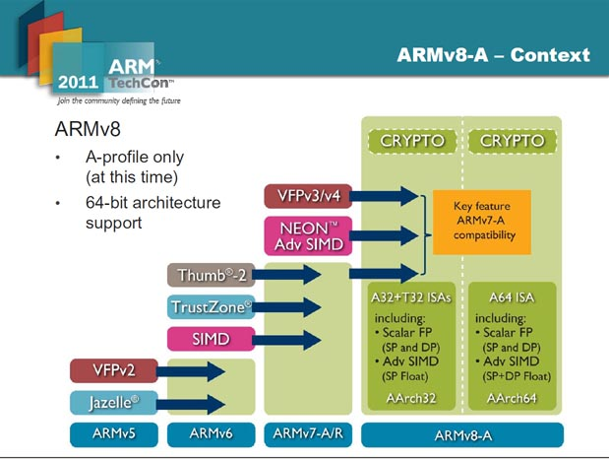
Specification of Raspberry Pi 3 (4/7) ARMv8 Architecture
Source: http://www.cpu-world.com/news_2011/2011110201_ARM_reveals_details_of_64-bit_ARMv8_architecture.html

Slide 7
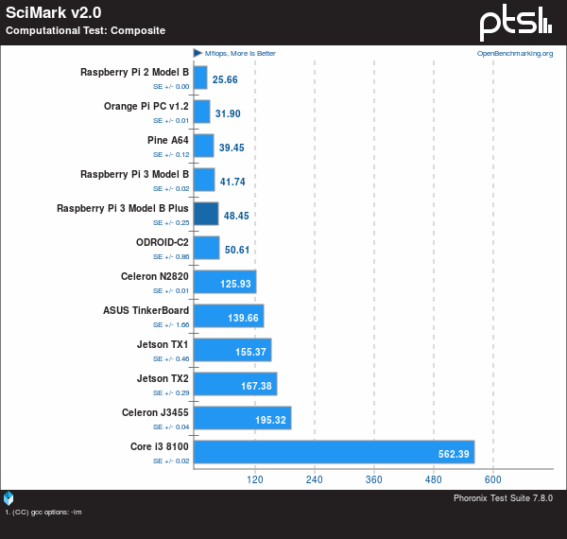
Specification of Raspberry Pi 3 (5/7) Benchmarking – Computational Test
Source: https://www.phoronix.com/scan.php?page=article&item=raspberrypi-3-bplus

Slide 8
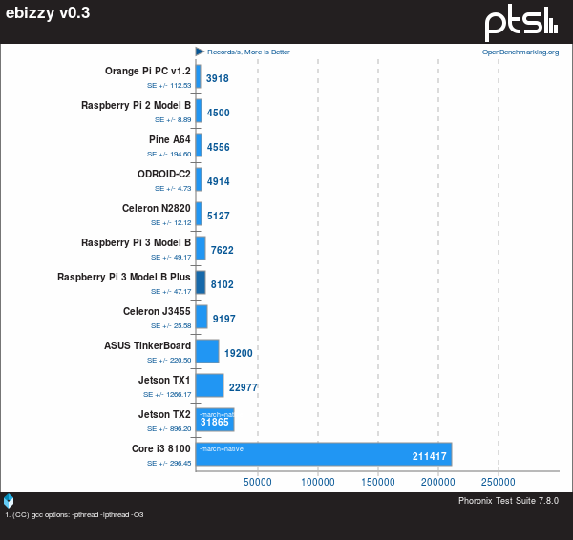
Specification of Raspberry Pi 3 (6/7) Benchmarking – Webserver Performance
Source: https://www.phoronix.com/scan.php?page=article&item=raspberrypi-3-bplus

Slide 9
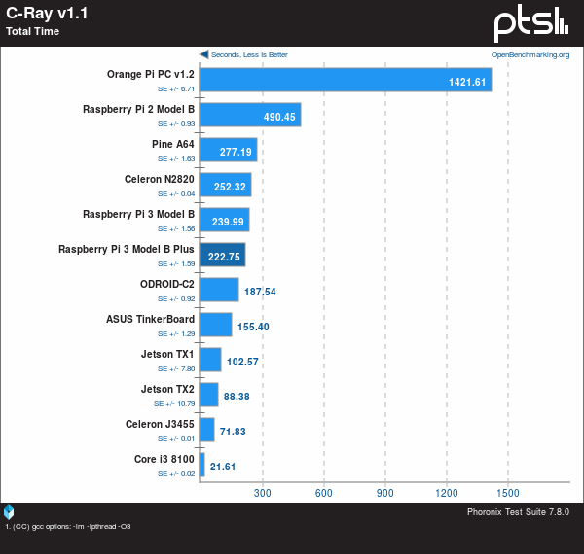
Specification of Raspberry Pi 3 (7/7) Benchmarking – Multi-Thread Performance
Source: https://www.phoronix.com/scan.php?page=article&item=raspberrypi-3-bplus

Slide 10
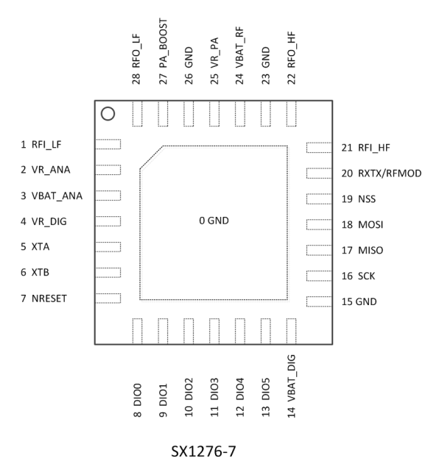
Specification of Mini LoRa (1/3) Chip Layout

Slide 11
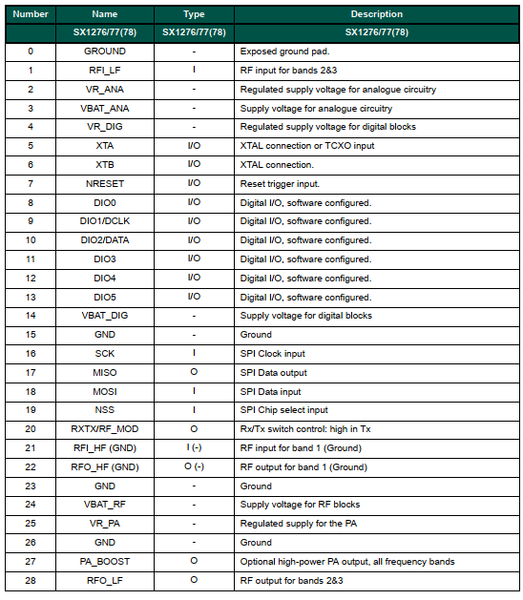
Specification of Mini LoRa (2/3) Pin Description

Slide 12
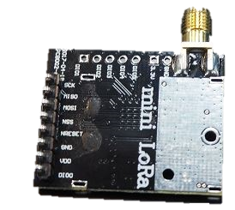
Specification of Mini LoRa (3/3) Module
SCK
MOSI
MISO
NSS
GND
VCC
DI00

Slide 13
Driver (Library)
C Version (STM32 Based): http://stackforce.github.io/LoRaMac-doc/index.html
Py Version (Raspberry pi Based): https://github.com/raspberrypi-tw/lora-sx1276

Slide 14
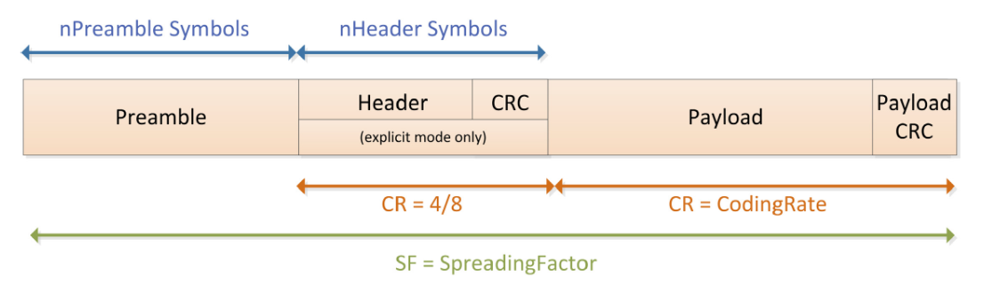
Data Packege

